Slide 1
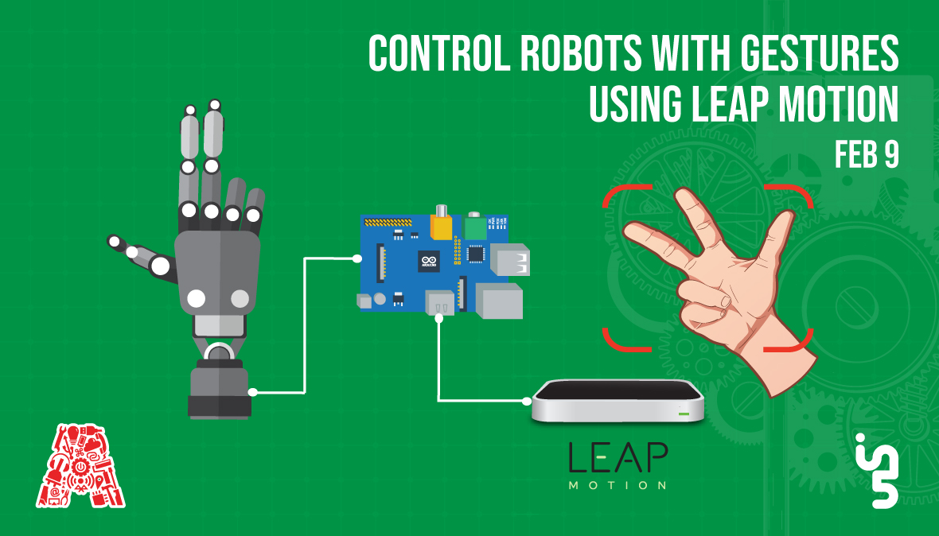

Slide 2
About the Assembly
A smart lab based out of In5 since Dec 2014
Over 200 free workshops done
ASSEMBLY: HACK - Embedded systems, iOT and hardware
ASSEMBLY: CODE - Software projects - APIs, frameworks, apps
Age range: 16-60 - students, professionals, entrepreneurs
Focus on smart technology and practical applications
Forum: members.theassembly.ae

Slide 3
TAG US ON OUR SOCIAL MEDIA
FACEBOOK
TWITTER
INSTAGRAM
YOUTUBE
The Assembly (@MakeSmartThings)
@MakeSmartThings
@MakeSmartThings
The Assembly

Slide 4
Agenda
Gesture Recognition Technology? What is it?
Gesture Control – Use Cases
Leap Motion Controller
Leap Motion SDK installation
Processing IDE
Library Installations
Arduino
Circuit Diagram
Processing Code
Workshop Task
GitHub repository
Notes:
*add cheat sheet for all the commands etc

Slide 5
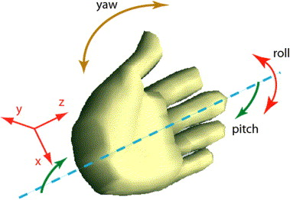
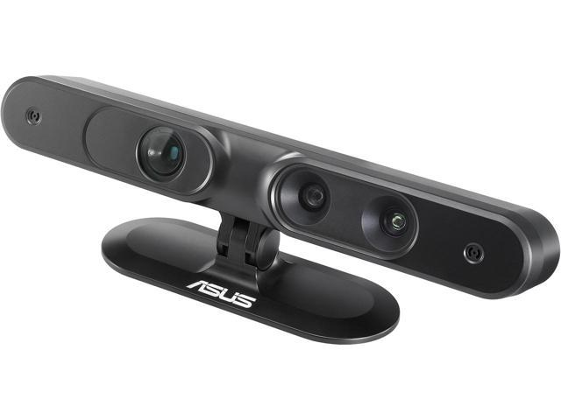
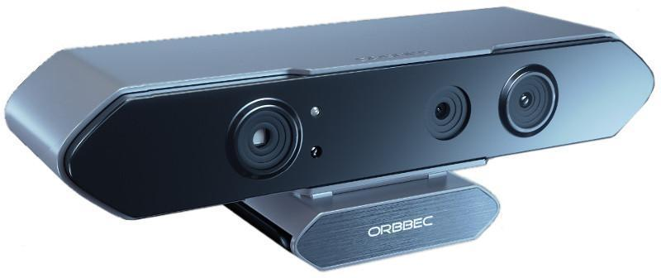
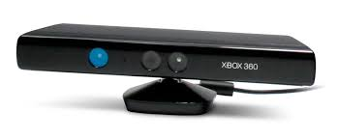
Gesture Recognition Technology
Mathematical interpretation of a human motion
by a computing device.
Computing device can be outfitted with a
camera so that software in the device can
recognize and interpret gestures or have
a wearable.
Kinect, Asus Xtion, Orbecc 3D, Leapmotion
Notes:
*add cheat sheet for all the commands etc
Hardware abstraction - where an operating system like ros communicate with hardware devices
Low level device control - Ros interacts with devices via a serial specific port to send or receive data
ROS has packages to support several robotic sensors such as range finders (LIDAR), Audio/ Speech detection, Cameras, Touch sensors, motion capture, RFID, speed, GPS/IMU and many more..
With ROS you can map and navigate your surrounding around the vicinity of a robot while simultaneously keeping track of its own location. Whenever an obstacle or an new object obstructing a bot the SLAM program updates the map too.
After SLAM comes navigation, with ROS you have full control over how you plan to navigate your robot, I’ll be showing that later
With ROS packages are bags of information that contain libraries, nodes, config files, etc., so managing packages is a core feature that ROS developers apply in order to organise and distribute these packages.
Unlike many IDEs ROS allows you to view all hidden processes, so when you build your ROS project you can view any possible errors, functions or Bugs through the debugger

Slide 6
Gesture Recognition Technology
WHY?
Touchless Natural User Interface : Removes the dependency on any mechanical devices like a keyboard or mouse
Recognizing gestures allows computers to be more accessible for the physically-impaired
Notes:
*add cheat sheet for all the commands etc
Hardware abstraction - where an operating system like ros communicate with hardware devices
Low level device control - Ros interacts with devices via a serial specific port to send or receive data
ROS has packages to support several robotic sensors such as range finders (LIDAR), Audio/ Speech detection, Cameras, Touch sensors, motion capture, RFID, speed, GPS/IMU and many more..
With ROS you can map and navigate your surrounding around the vicinity of a robot while simultaneously keeping track of its own location. Whenever an obstacle or an new object obstructing a bot the SLAM program updates the map too.
After SLAM comes navigation, with ROS you have full control over how you plan to navigate your robot, I’ll be showing that later
With ROS packages are bags of information that contain libraries, nodes, config files, etc., so managing packages is a core feature that ROS developers apply in order to organise and distribute these packages.
Unlike many IDEs ROS allows you to view all hidden processes, so when you build your ROS project you can view any possible errors, functions or Bugs through the debugger

Slide 7
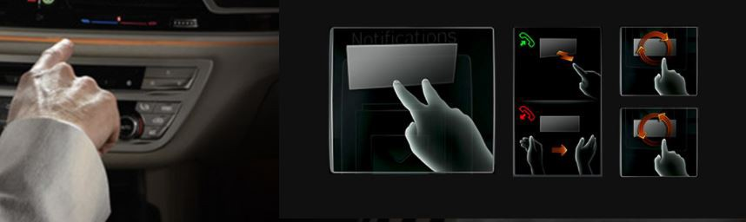

Gesture Control – Use Cases
Broad range
Retail
Transportation
VR/AR
Robot/Drone Control
Notes:
*add cheat sheet for all the commands etc
Hardware abstraction - where an operating system like ros communicate with hardware devices
Low level device control - Ros interacts with devices via a serial specific port to send or receive data
ROS has packages to support several robotic sensors such as range finders (LIDAR), Audio/ Speech detection, Cameras, Touch sensors, motion capture, RFID, speed, GPS/IMU and many more..
With ROS you can map and navigate your surrounding around the vicinity of a robot while simultaneously keeping track of its own location. Whenever an obstacle or an new object obstructing a bot the SLAM program updates the map too.
After SLAM comes navigation, with ROS you have full control over how you plan to navigate your robot, I’ll be showing that later
With ROS packages are bags of information that contain libraries, nodes, config files, etc., so managing packages is a core feature that ROS developers apply in order to organise and distribute these packages.
Unlike many IDEs ROS allows you to view all hidden processes, so when you build your ROS project you can view any possible errors, functions or Bugs through the debugger

Slide 8
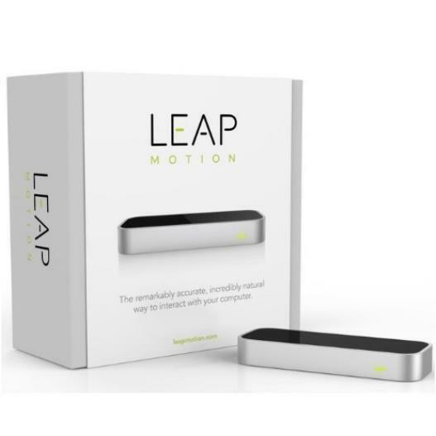
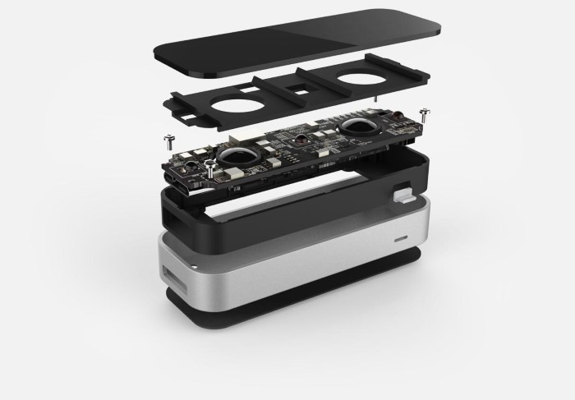
Leap Motion Controller
Notes:
*add cheat sheet for all the commands etc
Hardware abstraction - where an operating system like ros communicate with hardware devices
Low level device control - Ros interacts with devices via a serial specific port to send or receive data
ROS has packages to support several robotic sensors such as range finders (LIDAR), Audio/ Speech detection, Cameras, Touch sensors, motion capture, RFID, speed, GPS/IMU and many more..
With ROS you can map and navigate your surrounding around the vicinity of a robot while simultaneously keeping track of its own location. Whenever an obstacle or an new object obstructing a bot the SLAM program updates the map too.
After SLAM comes navigation, with ROS you have full control over how you plan to navigate your robot, I’ll be showing that later
With ROS packages are bags of information that contain libraries, nodes, config files, etc., so managing packages is a core feature that ROS developers apply in order to organise and distribute these packages.
Unlike many IDEs ROS allows you to view all hidden processes, so when you build your ROS project you can view any possible errors, functions or Bugs through the debugger

Slide 9
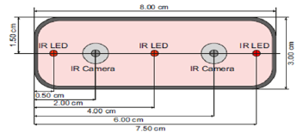
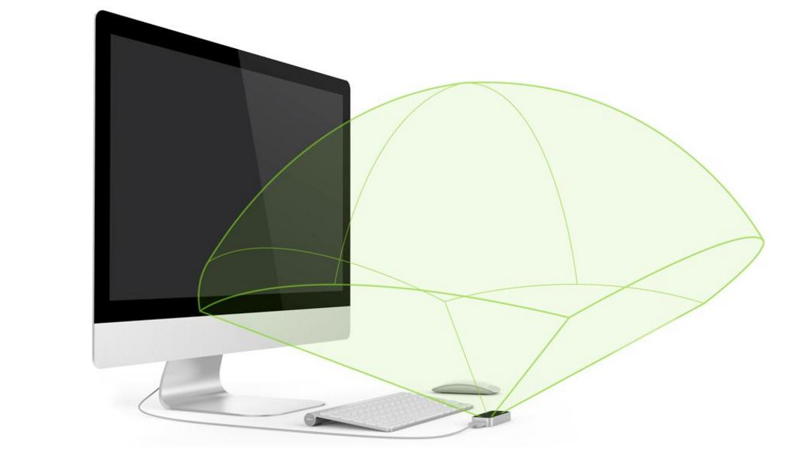
Leap Motion Controller
How it works?
Two monochromatic IR cameras
Three IR LEDs
Roughly Hemispherical area, up to 1m
LEDs generate a pattern-less IR light and camera generates almost 200 frames per second of the reflected data
Orion Software – Latest SDK
Notes:
*add cheat sheet for all the commands etc
Hardware abstraction - where an operating system like ros communicate with hardware devices
Low level device control - Ros interacts with devices via a serial specific port to send or receive data
ROS has packages to support several robotic sensors such as range finders (LIDAR), Audio/ Speech detection, Cameras, Touch sensors, motion capture, RFID, speed, GPS/IMU and many more..
With ROS you can map and navigate your surrounding around the vicinity of a robot while simultaneously keeping track of its own location. Whenever an obstacle or an new object obstructing a bot the SLAM program updates the map too.
After SLAM comes navigation, with ROS you have full control over how you plan to navigate your robot, I’ll be showing that later
With ROS packages are bags of information that contain libraries, nodes, config files, etc., so managing packages is a core feature that ROS developers apply in order to organise and distribute these packages.
Unlike many IDEs ROS allows you to view all hidden processes, so when you build your ROS project you can view any possible errors, functions or Bugs through the debugger

Slide 10
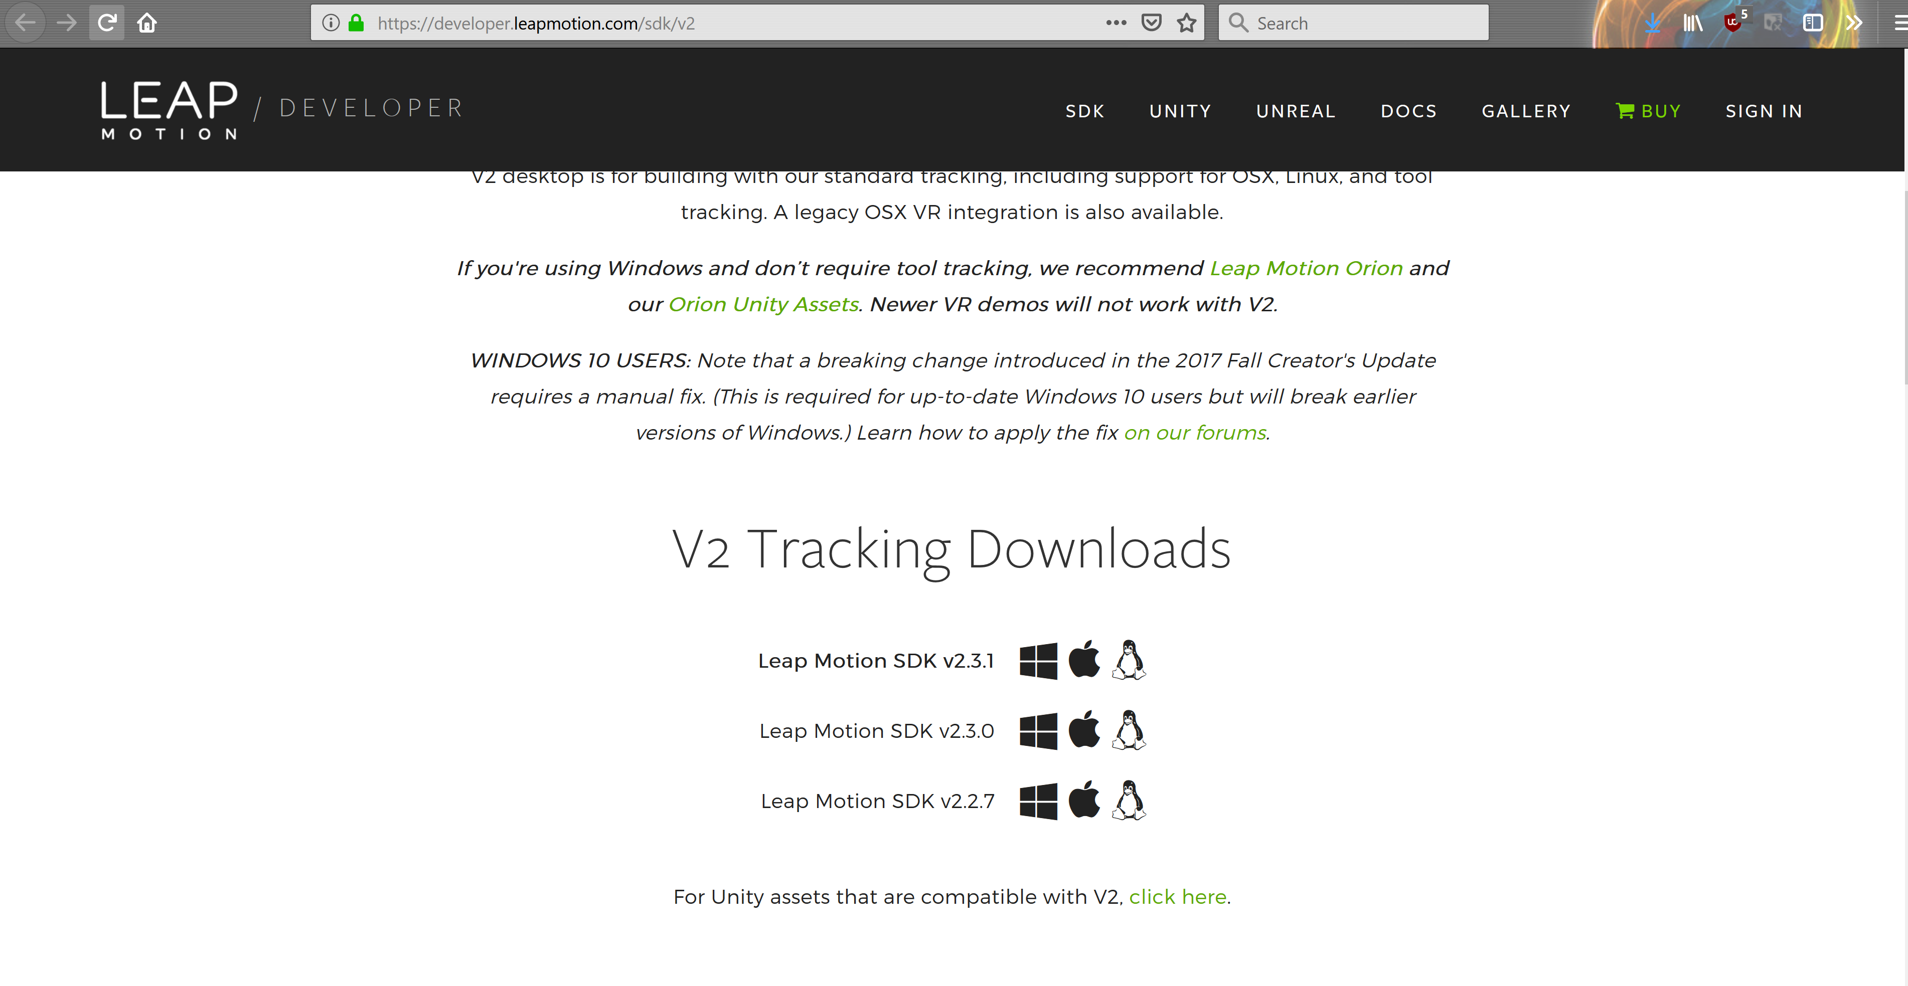
Leap Motion SDK Installation
Install the leap motion SDK v2.3.1 from the website: https://developer.leapmotion.com/sdk/v2
Notes:
*add cheat sheet for all the commands etc
Hardware abstraction - where an operating system like ros communicate with hardware devices
Low level device control - Ros interacts with devices via a serial specific port to send or receive data
ROS has packages to support several robotic sensors such as range finders (LIDAR), Audio/ Speech detection, Cameras, Touch sensors, motion capture, RFID, speed, GPS/IMU and many more..
With ROS you can map and navigate your surrounding around the vicinity of a robot while simultaneously keeping track of its own location. Whenever an obstacle or an new object obstructing a bot the SLAM program updates the map too.
After SLAM comes navigation, with ROS you have full control over how you plan to navigate your robot, I’ll be showing that later
With ROS packages are bags of information that contain libraries, nodes, config files, etc., so managing packages is a core feature that ROS developers apply in order to organise and distribute these packages.
Unlike many IDEs ROS allows you to view all hidden processes, so when you build your ROS project you can view any possible errors, functions or Bugs through the debugger

Slide 11
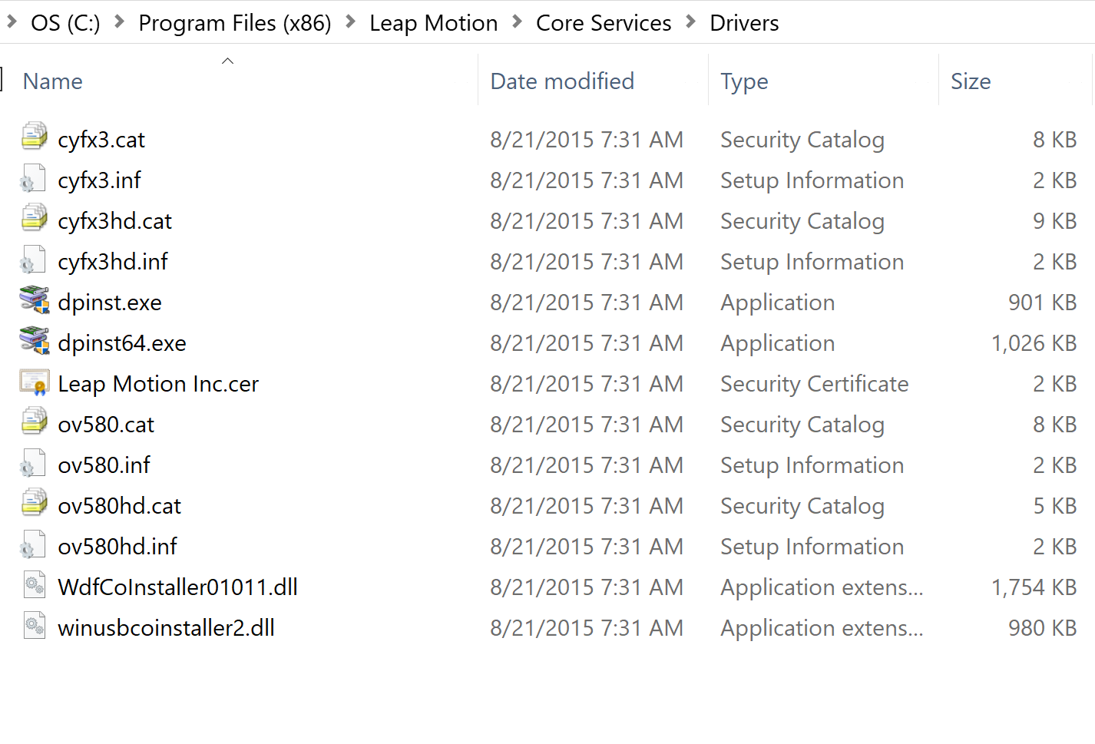
Leap Motion SDK Installation
Install Leap motion driver package: Go to Program Files(x86) > Leap Motion > Core Services > Drivers and run dpinst.exe (dpinst64.exe if you have a 64-bit machine)
Notes:
*add cheat sheet for all the commands etc
Hardware abstraction - where an operating system like ros communicate with hardware devices
Low level device control - Ros interacts with devices via a serial specific port to send or receive data
ROS has packages to support several robotic sensors such as range finders (LIDAR), Audio/ Speech detection, Cameras, Touch sensors, motion capture, RFID, speed, GPS/IMU and many more..
With ROS you can map and navigate your surrounding around the vicinity of a robot while simultaneously keeping track of its own location. Whenever an obstacle or an new object obstructing a bot the SLAM program updates the map too.
After SLAM comes navigation, with ROS you have full control over how you plan to navigate your robot, I’ll be showing that later
With ROS packages are bags of information that contain libraries, nodes, config files, etc., so managing packages is a core feature that ROS developers apply in order to organise and distribute these packages.
Unlike many IDEs ROS allows you to view all hidden processes, so when you build your ROS project you can view any possible errors, functions or Bugs through the debugger

Slide 12
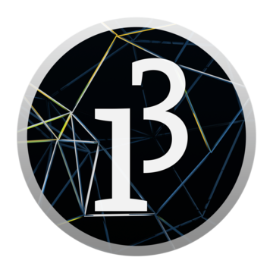
Processing IDE
Processing is an open-source graphical library and integrated development environment (IDE)
Java Programming language
Great for working with Arduino
Latest version: 3.4
Notes:
*add cheat sheet for all the commands etc
Hardware abstraction - where an operating system like ros communicate with hardware devices
Low level device control - Ros interacts with devices via a serial specific port to send or receive data
ROS has packages to support several robotic sensors such as range finders (LIDAR), Audio/ Speech detection, Cameras, Touch sensors, motion capture, RFID, speed, GPS/IMU and many more..
With ROS you can map and navigate your surrounding around the vicinity of a robot while simultaneously keeping track of its own location. Whenever an obstacle or an new object obstructing a bot the SLAM program updates the map too.
After SLAM comes navigation, with ROS you have full control over how you plan to navigate your robot, I’ll be showing that later
With ROS packages are bags of information that contain libraries, nodes, config files, etc., so managing packages is a core feature that ROS developers apply in order to organise and distribute these packages.
Unlike many IDEs ROS allows you to view all hidden processes, so when you build your ROS project you can view any possible errors, functions or Bugs through the debugger

Slide 13
Library Installations
Go to Sketch > Import Library > Add Library
Search for Arduino (Firmata) and download
Search for Leap Motion for Processing and download
Restart Processing after you’re done
Notes:
*add cheat sheet for all the commands etc
Hardware abstraction - where an operating system like ros communicate with hardware devices
Low level device control - Ros interacts with devices via a serial specific port to send or receive data
ROS has packages to support several robotic sensors such as range finders (LIDAR), Audio/ Speech detection, Cameras, Touch sensors, motion capture, RFID, speed, GPS/IMU and many more..
With ROS you can map and navigate your surrounding around the vicinity of a robot while simultaneously keeping track of its own location. Whenever an obstacle or an new object obstructing a bot the SLAM program updates the map too.
After SLAM comes navigation, with ROS you have full control over how you plan to navigate your robot, I’ll be showing that later
With ROS packages are bags of information that contain libraries, nodes, config files, etc., so managing packages is a core feature that ROS developers apply in order to organise and distribute these packages.
Unlike many IDEs ROS allows you to view all hidden processes, so when you build your ROS project you can view any possible errors, functions or Bugs through the debugger

Slide 14
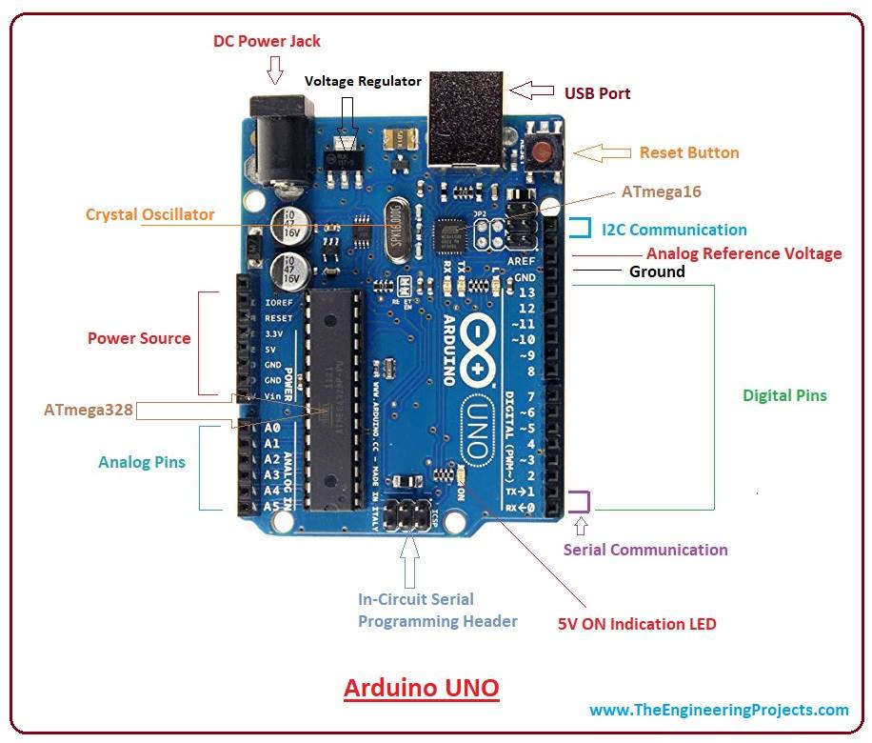
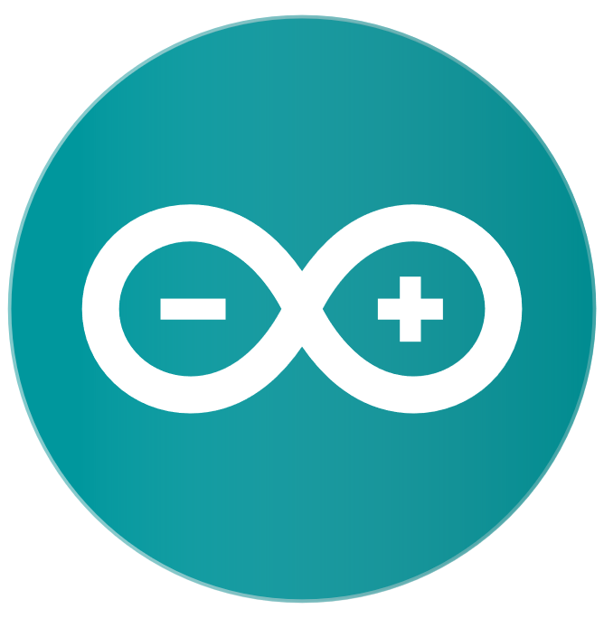
Arduino
Open-source microcontroller board
based on the Microchip ATmega328P
Equipped with sets of digital and
analogue input/output (I/O) pins
Notes:
*add cheat sheet for all the commands etc
Hardware abstraction - where an operating system like ros communicate with hardware devices
Low level device control - Ros interacts with devices via a serial specific port to send or receive data
ROS has packages to support several robotic sensors such as range finders (LIDAR), Audio/ Speech detection, Cameras, Touch sensors, motion capture, RFID, speed, GPS/IMU and many more..
With ROS you can map and navigate your surrounding around the vicinity of a robot while simultaneously keeping track of its own location. Whenever an obstacle or an new object obstructing a bot the SLAM program updates the map too.
After SLAM comes navigation, with ROS you have full control over how you plan to navigate your robot, I’ll be showing that later
With ROS packages are bags of information that contain libraries, nodes, config files, etc., so managing packages is a core feature that ROS developers apply in order to organise and distribute these packages.
Unlike many IDEs ROS allows you to view all hidden processes, so when you build your ROS project you can view any possible errors, functions or Bugs through the debugger

Slide 15
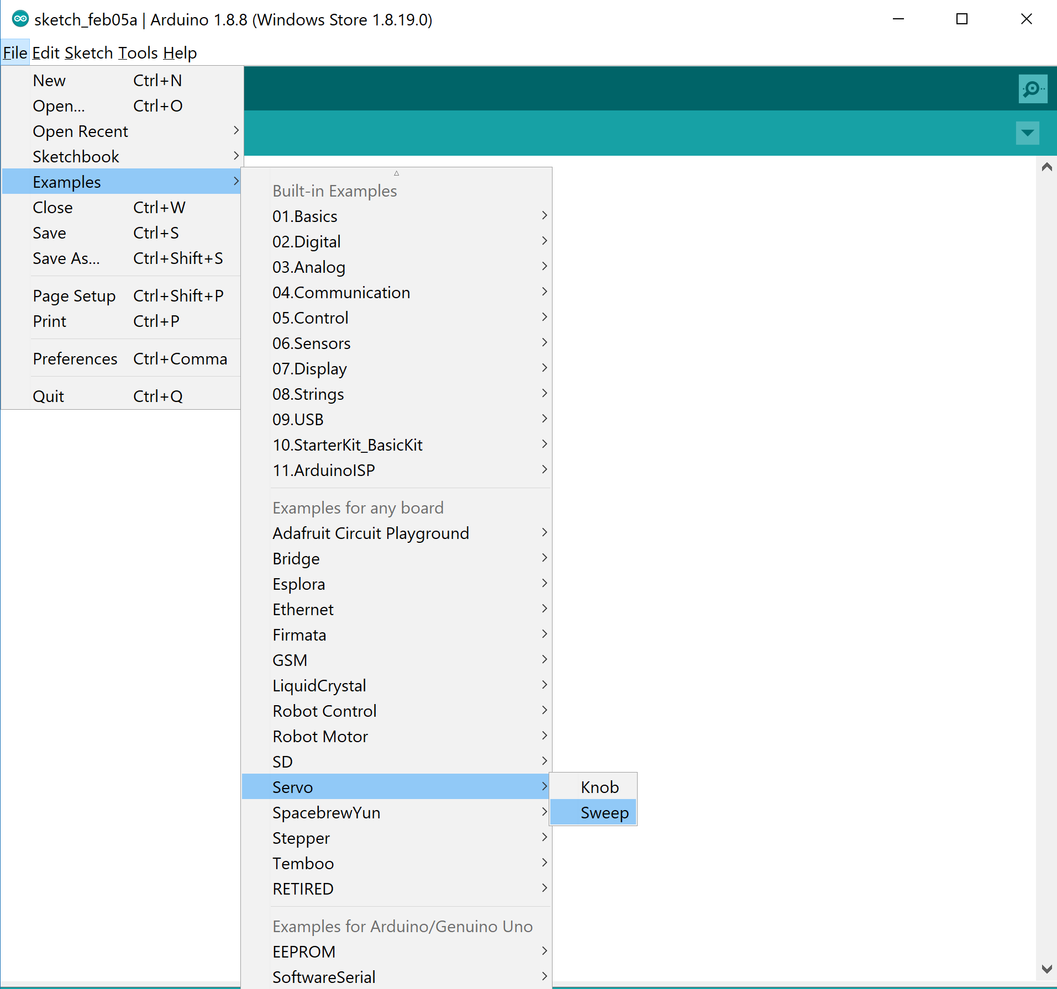
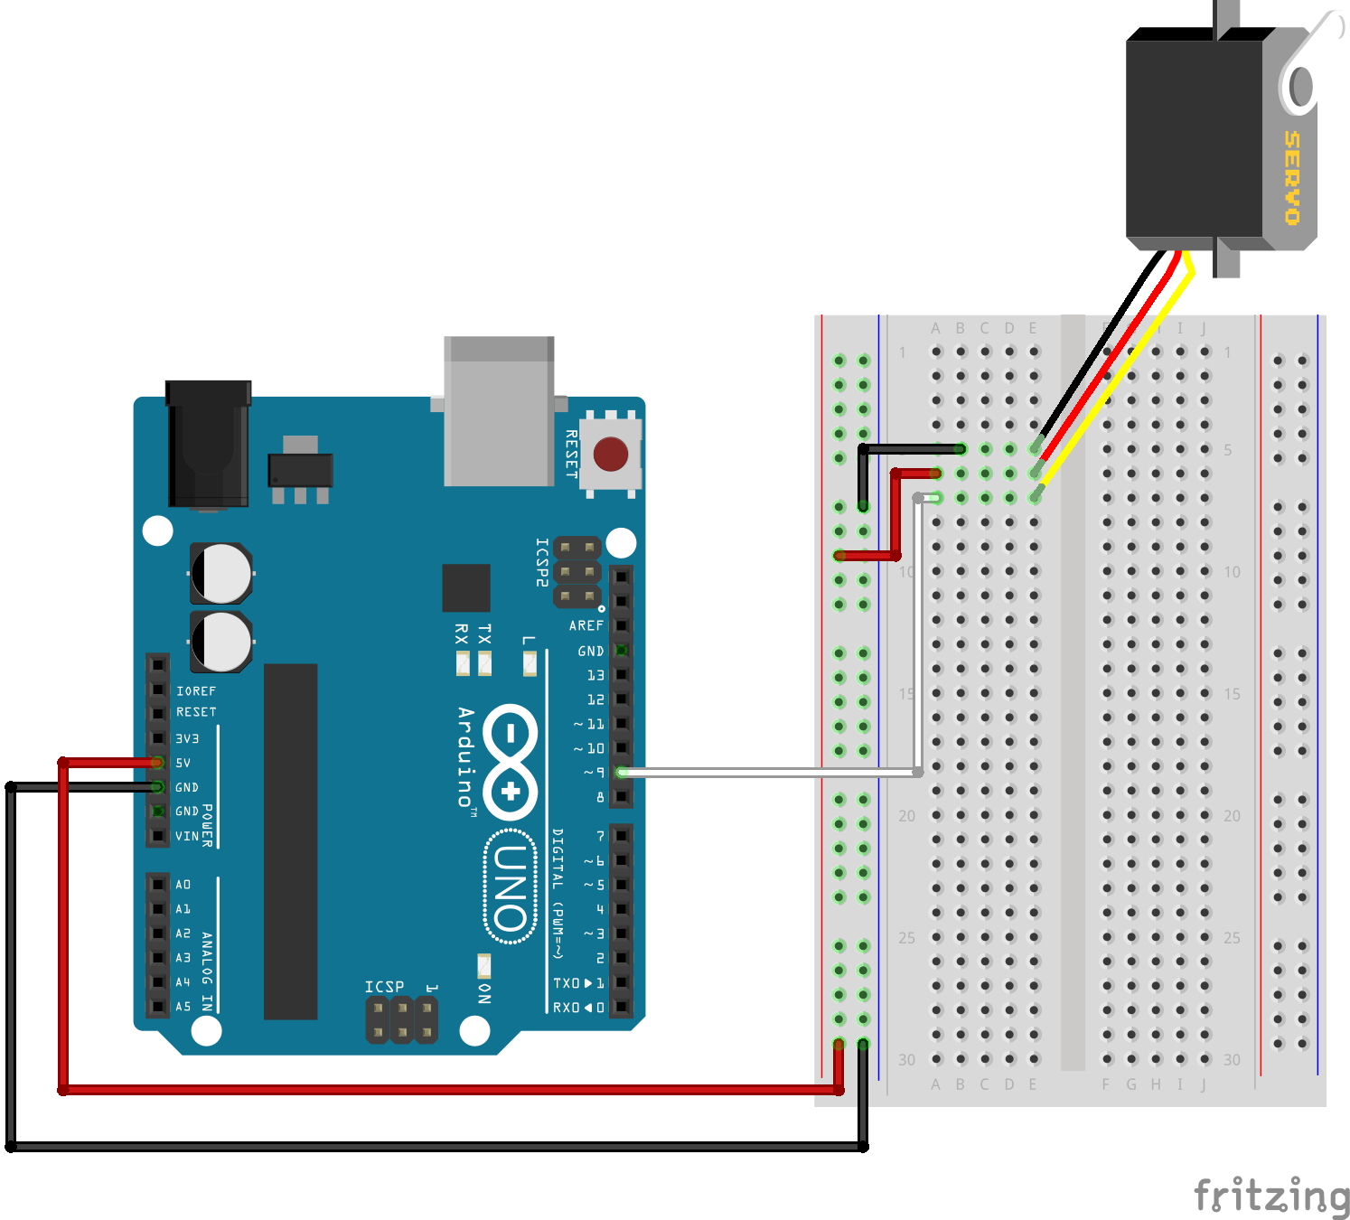
Arduino & Servos
Open Arduino IDE, go to File > Examples > Servo > Sweep. Run this code on Arduino
Notes:
*add cheat sheet for all the commands etc
Hardware abstraction - where an operating system like ros communicate with hardware devices
Low level device control - Ros interacts with devices via a serial specific port to send or receive data
ROS has packages to support several robotic sensors such as range finders (LIDAR), Audio/ Speech detection, Cameras, Touch sensors, motion capture, RFID, speed, GPS/IMU and many more..
With ROS you can map and navigate your surrounding around the vicinity of a robot while simultaneously keeping track of its own location. Whenever an obstacle or an new object obstructing a bot the SLAM program updates the map too.
After SLAM comes navigation, with ROS you have full control over how you plan to navigate your robot, I’ll be showing that later
With ROS packages are bags of information that contain libraries, nodes, config files, etc., so managing packages is a core feature that ROS developers apply in order to organise and distribute these packages.
Unlike many IDEs ROS allows you to view all hidden processes, so when you build your ROS project you can view any possible errors, functions or Bugs through the debugger

Slide 16
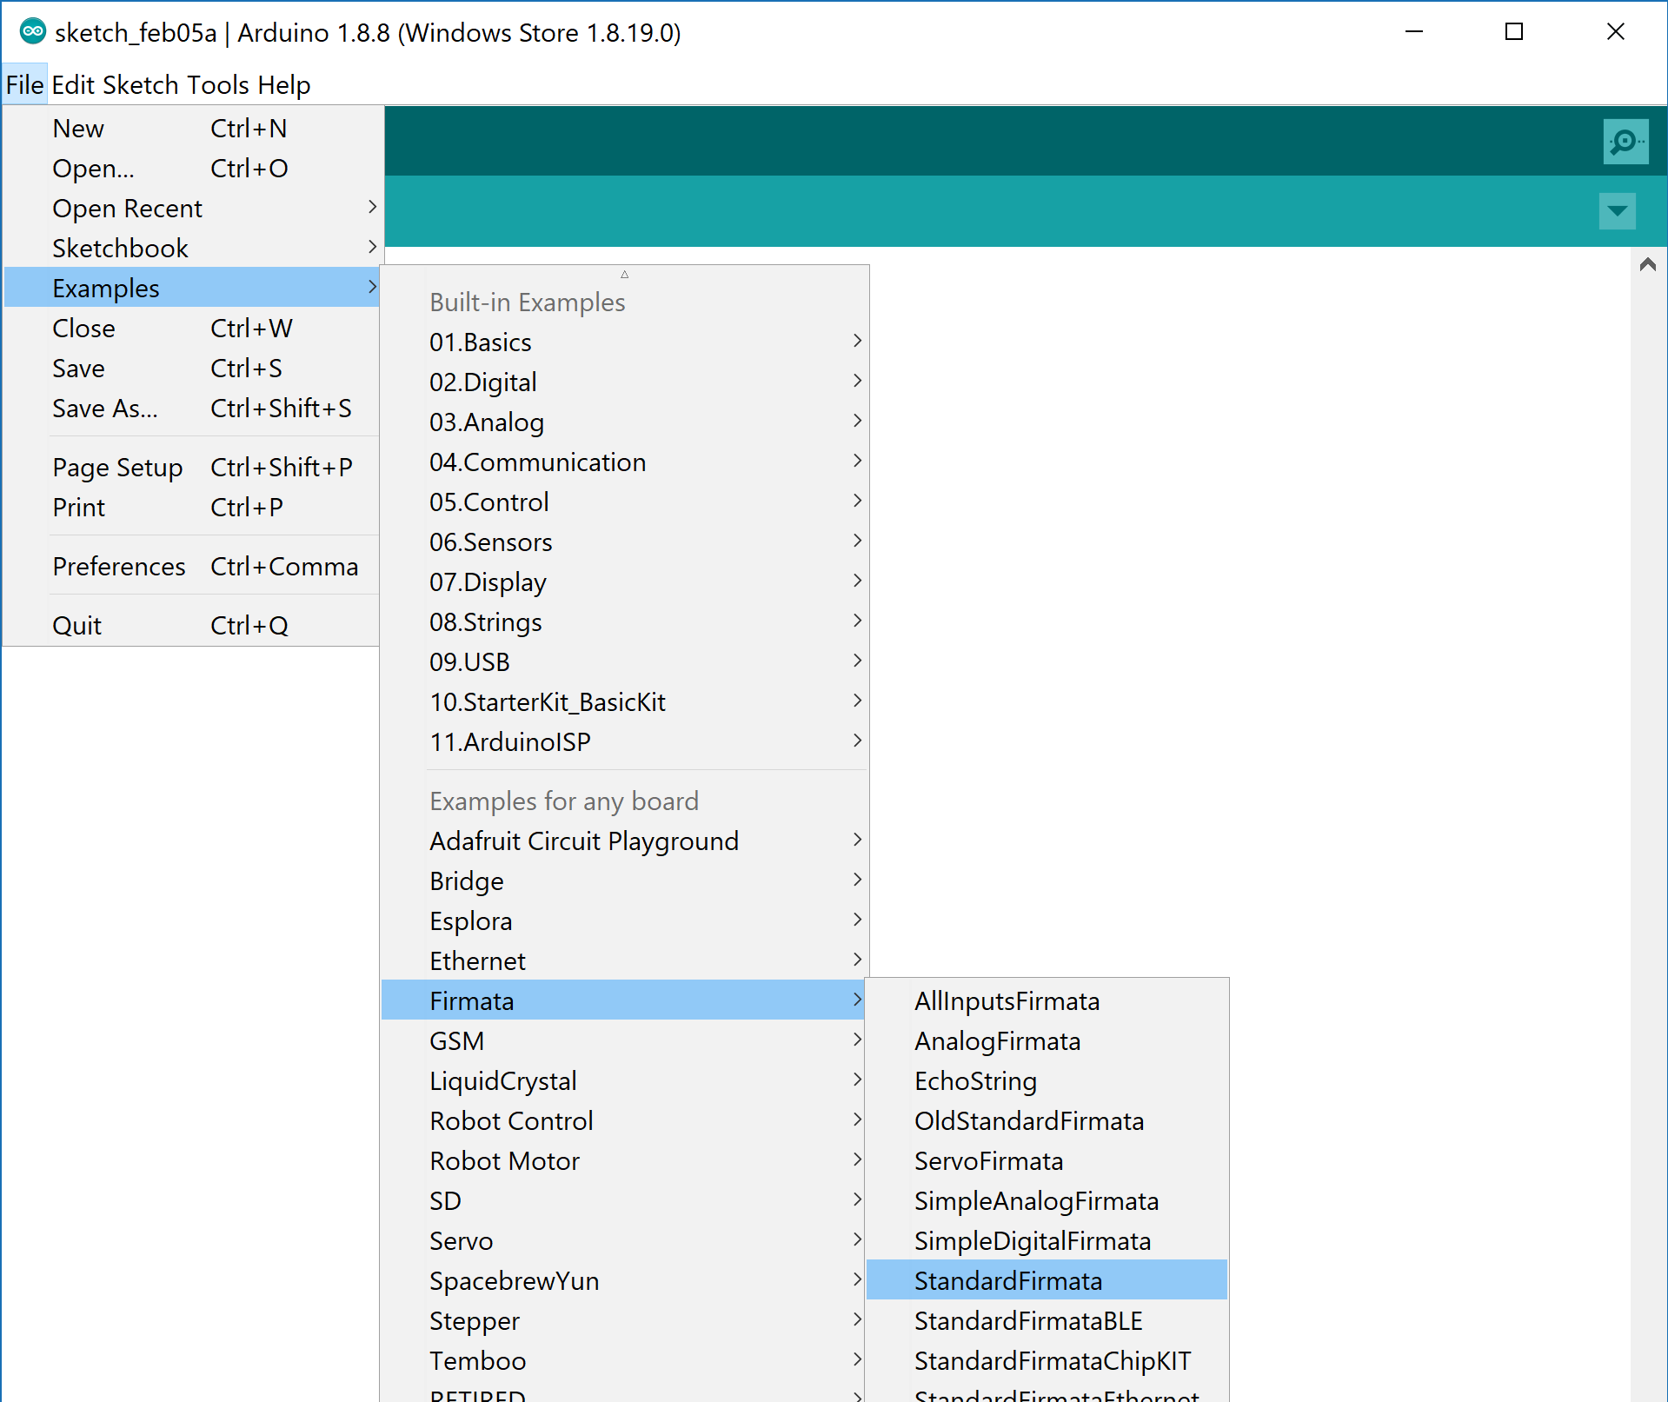
Arduino & Firmata
The Firmata library implements the Firmata protocol for communicating with software on the host computer
Go to File > Examples > Firmata > Standard Firmata. Open the file and upload it to Arduino
Upload Firmata Library on Arduino
Notes:
*add cheat sheet for all the commands etc
Hardware abstraction - where an operating system like ros communicate with hardware devices
Low level device control - Ros interacts with devices via a serial specific port to send or receive data
ROS has packages to support several robotic sensors such as range finders (LIDAR), Audio/ Speech detection, Cameras, Touch sensors, motion capture, RFID, speed, GPS/IMU and many more..
With ROS you can map and navigate your surrounding around the vicinity of a robot while simultaneously keeping track of its own location. Whenever an obstacle or an new object obstructing a bot the SLAM program updates the map too.
After SLAM comes navigation, with ROS you have full control over how you plan to navigate your robot, I’ll be showing that later
With ROS packages are bags of information that contain libraries, nodes, config files, etc., so managing packages is a core feature that ROS developers apply in order to organise and distribute these packages.
Unlike many IDEs ROS allows you to view all hidden processes, so when you build your ROS project you can view any possible errors, functions or Bugs through the debugger

Slide 17
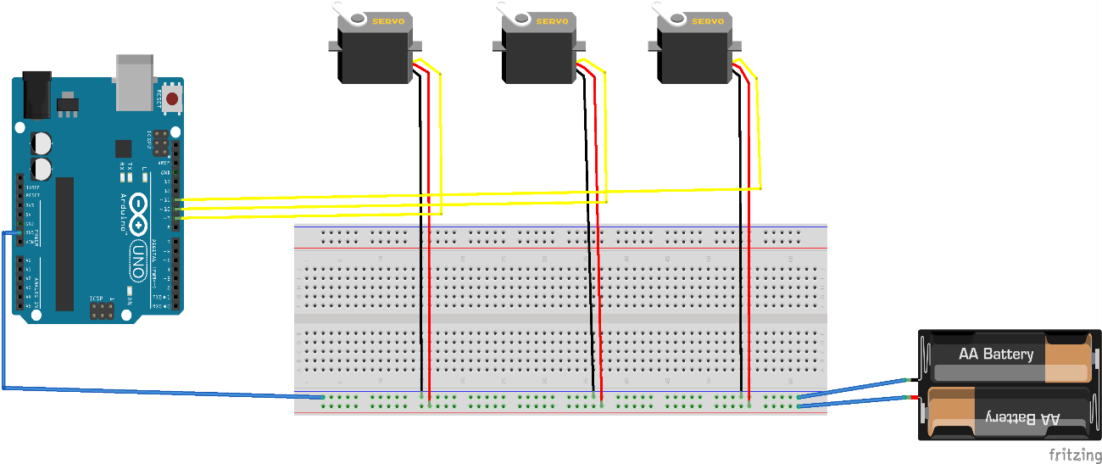
Circuit Diagram
Notes:
*add cheat sheet for all the commands etc
Hardware abstraction - where an operating system like ros communicate with hardware devices
Low level device control - Ros interacts with devices via a serial specific port to send or receive data
ROS has packages to support several robotic sensors such as range finders (LIDAR), Audio/ Speech detection, Cameras, Touch sensors, motion capture, RFID, speed, GPS/IMU and many more..
With ROS you can map and navigate your surrounding around the vicinity of a robot while simultaneously keeping track of its own location. Whenever an obstacle or an new object obstructing a bot the SLAM program updates the map too.
After SLAM comes navigation, with ROS you have full control over how you plan to navigate your robot, I’ll be showing that later
With ROS packages are bags of information that contain libraries, nodes, config files, etc., so managing packages is a core feature that ROS developers apply in order to organise and distribute these packages.
Unlike many IDEs ROS allows you to view all hidden processes, so when you build your ROS project you can view any possible errors, functions or Bugs through the debugger

Slide 18
Workshop Task
We have incorporated the control of index, middle and thumb fingers.
Your task is to:
Write the code for the ring and pinky finger
Attach the servo on to the foamboard (Get crafty!)
Test with the leap motion controller
Notes:
*add cheat sheet for all the commands etc
Hardware abstraction - where an operating system like ros communicate with hardware devices
Low level device control - Ros interacts with devices via a serial specific port to send or receive data
ROS has packages to support several robotic sensors such as range finders (LIDAR), Audio/ Speech detection, Cameras, Touch sensors, motion capture, RFID, speed, GPS/IMU and many more..
With ROS you can map and navigate your surrounding around the vicinity of a robot while simultaneously keeping track of its own location. Whenever an obstacle or an new object obstructing a bot the SLAM program updates the map too.
After SLAM comes navigation, with ROS you have full control over how you plan to navigate your robot, I’ll be showing that later
With ROS packages are bags of information that contain libraries, nodes, config files, etc., so managing packages is a core feature that ROS developers apply in order to organise and distribute these packages.
Unlike many IDEs ROS allows you to view all hidden processes, so when you build your ROS project you can view any possible errors, functions or Bugs through the debugger

Slide 19
GitHub Repository
Notes:
*add cheat sheet for all the commands etc
Hardware abstraction - where an operating system like ros communicate with hardware devices
Low level device control - Ros interacts with devices via a serial specific port to send or receive data
ROS has packages to support several robotic sensors such as range finders (LIDAR), Audio/ Speech detection, Cameras, Touch sensors, motion capture, RFID, speed, GPS/IMU and many more..
With ROS you can map and navigate your surrounding around the vicinity of a robot while simultaneously keeping track of its own location. Whenever an obstacle or an new object obstructing a bot the SLAM program updates the map too.
After SLAM comes navigation, with ROS you have full control over how you plan to navigate your robot, I’ll be showing that later
With ROS packages are bags of information that contain libraries, nodes, config files, etc., so managing packages is a core feature that ROS developers apply in order to organise and distribute these packages.
Unlike many IDEs ROS allows you to view all hidden processes, so when you build your ROS project you can view any possible errors, functions or Bugs through the debugger

